Slide 1
Nina Ozlu Tunceli
Oceanside, CA May 12, 2014

Slide 2
Arts Action Fund Mission
Build political influence to ensure bipartisan support for a pro-arts majority in Congress
Promote public policies that provide individuals and families affordable access to all forms of the arts
Stand up for every child’s right to a comprehensive, high quality arts education
Rally national support against attacks to the arts
www.ArtsActionFund.org

Slide 3
Arts Action Fund Goals
Enlist 1 Million advocate members by the 2016 Presidential election
Raise $250,000 in PAC dollars to support pro-arts candidates for every 2-year election cycle

Slide 4
Difference between nonprofits
501c4 – Americans for the Arts Action Fund
Social welfare organization
Up to 100% lobbying
Some political electioneering (less than 50%)
501c3 – Americans for the Arts
Charitable organization
Limits on lobbying, but fairly generous still
No electioneering

Slide 5
Definitions for 501(c)(3) nonprofits
LOBBYING
In general, Direct lobbying is defined as communication made on behalf of your organization with a legislator or their staff (federal, state, local or foreign governments) that references specific legislation and articulates a position on that legislation. All three requirements must be met.
Grassroots lobbying is defined as asking the general public to directly lobby their elected officials.
ADVOCACY
While “lobbying” is a component of advocacy, the range of advocacy activities can be far greater, with no legal spending restrictions. Advocacy is a form of communication in support of a cause, which can include media education, public awareness campaigns, advertising, training workshops, public opinion polling, position and policy papers, voter education, visibility events, recognition awards, and other types of promotional efforts.

Slide 6
Financial Lobbying Limits for a 501c3
A generous amount:
20 percent of the first $500,000 of annual expenditures;
15 percent of the next $500,000;
10 percent of the next $500,000;
5 percent for every additional $500,000 up to $1 million maximum per year.

Slide 7
Grassroots Lobbying Expenditures
Charitable 501c3 nonprofits may spend 25% of their total allowable lobbying expenditures on grassroots lobbying.
ABC nonprofit with annual general expenditures of $500,000.
20% of $500,000 = $100,000 = Overall lobbying limit
25% of $100,000 = $25,000 = Grassroots lobbying limit
Organization can spend up to $25,000 on grassroots lobbying, and $75,000 on direct lobbying or all $100,000 on direct lobbying.
Notes:
The Nonprofit Lobbying Guide, the second edition by Bob Smucker
Page 8

Slide 8
Ballot Initiative Work is Direct Lobbying
Public becomes the legislature.
Lobbying the public to vote for or against a legislative/constitutional measure.
This is important because (c)(3)s can spend more on direct lobbying.
Close to 85% of all local and state arts ballot initiatives have passed.
Notes:
The Nonprofit Lobbying Guide, the second edition by Bob Smucker
Page 8 - 11

Slide 9
Basic Rule for 501c3s in an Election Year
501(c)(3) charitable organizations may engage in educational activities related to the electoral process as long as they do not:
participate or intervene
in any political campaign
in support of, or in opposition to, any candidate for public office

Slide 10
Permissible Educational Activities
Candidate questionnaires
Candidate forums
Officeholder scorecards
Voter registration, GOTV
Issue education
The issue is when and what do you do with the information, did you cover a range of issues, and what’s your prior history of releasing this information.

Slide 11
Election Activities & Supporting Pro-Arts Candidates
Celebrate & Evaluate
Identify Problems and Obstacles
Policy Action Outcomes & Voting Results
Identify Solutions & Opportunities
Lobbying Decision-makers
Research & Polling
Visibility & Media of what’s at stake
Messaging, Identifying Targets & Coalition Building
Recruiting & Training Grassroots & Grasstops

Slide 12
Impacting Public Policy
Elected
Official
Grassroots
Grasstops
National
Organizations
Peer-to-Peer
Media
Grassroots
Media
Grasstops
Peer-to-Peer
Coalitions of Orgs.

Slide 13
Strength Through Collective Action
Diversity of Arts Disciplines
Organizational Size Diversity
Cultural & Ethnic Diversity
Geographic Diversity
(rural, urban, suburban)

Slide 14
Power of a Unified Message
Present a unified position to elected officials, the media, the public and your grassroots members.
Work out differences behind closed doors among yourselves.
If you show cracks in your position, your opponents will take advantage.
When grassroots arts advocates are properly mobilized with a unified message, it’s as powerful as the lobbyists of well-funded industries.

Slide 15
Communicating Public Benefits
Make Policy Issues Personal. Humanize the issue with a story.
Articulate a Range of Public Benefits
Instrumental purposes of the arts
Intrinsic value of the arts

Slide 16
10 Reasons to Support the Arts
1. Arts are fundamental to our humanity.
2. Arts improve overall academic performance.
3. Arts economy is big, representing 3.2% of national GDP.
4. Arts are good for local merchants and attract new businesses.
5. Arts drive tourism, especially from abroad.
6. Arts are a $72 billion export industry with a $47 billon trade surplus.
7. Arts spark creativity and innovation needed for 21st century workforce.
8. Arts encourage civic engagement and have social impact.
9. Arts enhance health and healing.
10. Arts mean business with 750,000 arts-related businesses and 3.1 jobs.

Slide 17
Creative Industries – California

Slide 18
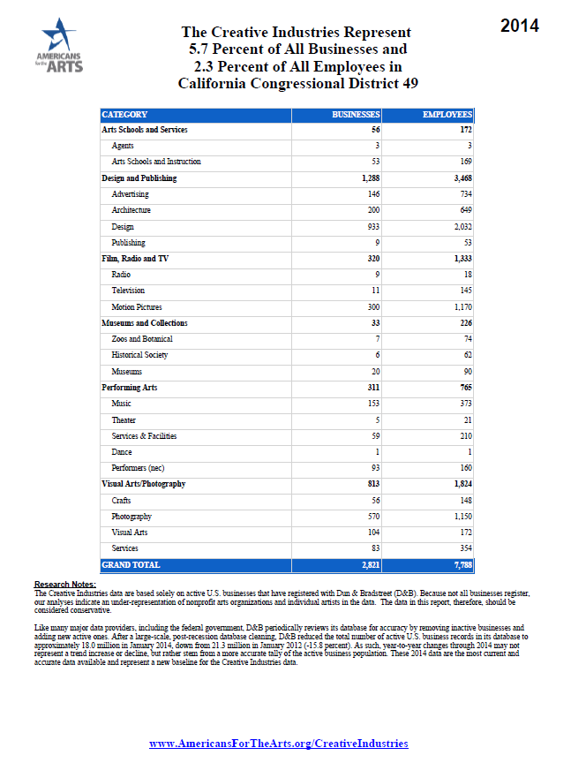
Creative Industries CA-49

Slide 19
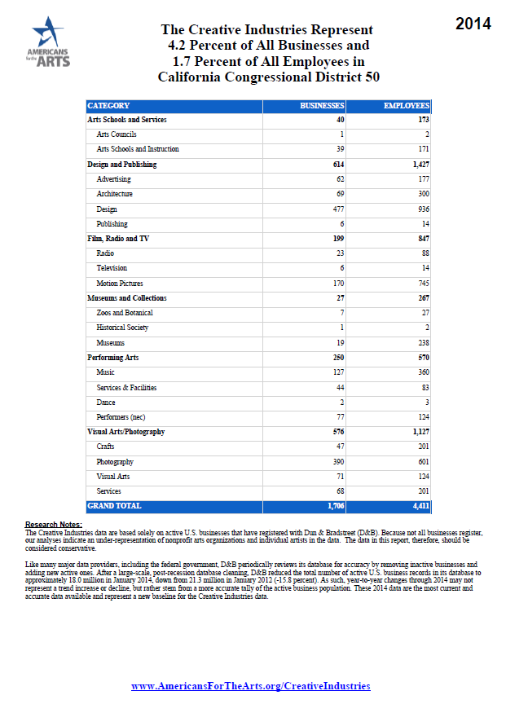
Creative Industries CA-45

Slide 20
Key California Committee Assignments
SUBCOMMITTEE ON INTERIOR APPROPRIATIONS
Ken Calvert (R-CA-42-Corona) – new CHAIRMAN
David Valadao (R-CA-21-Bakersfield)
Sen. Dianne Feinstein (D-CA-entire state)
SUBCOMMITTEE ON EARLY CHILDHOOD, ELEMENTARY & SECONDARY EDUCATION
Duncan Hunter (R-CA-50-Escondido)
Susan Davis (D-CA-53-San Diego)
SUBCOMMITTEE ON EDUCATION APPROPRIATIONS
Lucille Roybal-Allard (D-CA-40-South Los Angeles)
Barbara Lee (D-CA-13-Oakland)
Michael Honda (D-CA-17-San Jose)
TAX-WRITING COMMITTEES
Xavier Becerra (D-CA-34-Los Angeles)
Mike Thompson (D-CA-5-Napa)
Linda Sanchez (D-CA-38-Cerritos)
Devin Nunes (R-CA-22-Visalia)

Slide 21
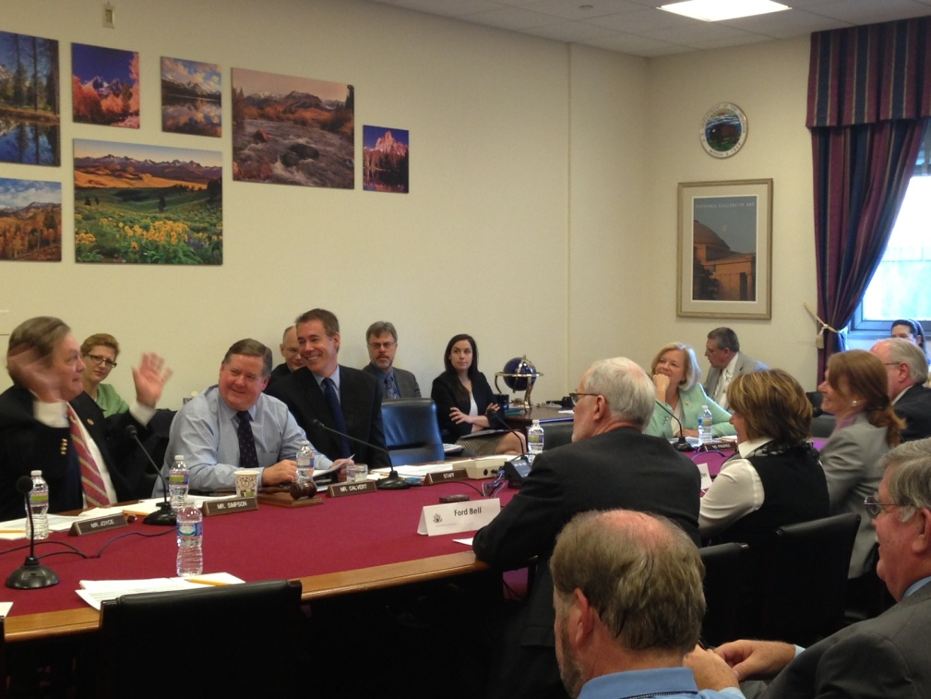
Chairman Ken Calvert (R-CA-42)
Pam Hogan , E.D. of Fender Performing Arts Center testified on behalf of Americans for the Arts on 4/10/14 before House Interior Appropriations Subcommittee chaired by Rep. Ken Calvert. She requested that the NEA’s budget be increased to $155 million next year.

Slide 22
National Petitions – Fall 2013
Over 40,0000 Signatures collected and delivered to Congress w/in 3 weeks
Our membership helps create momentum and a louder voice for our arts platform
No cuts were made to the NEA or NEH.

Slide 23
Federal Programs & FY14 Budgets
National Endowment for the Arts @ $146 million
National Endowment for the Humanities @ $146 mil.
Institute of Museum & Libraries @ $226 million
Dept of Education AIE @ $25 million
Corporation for Public Broadcasting @ $445 million
Smithsonian $805 million
Nat’l Gallery of Art @ $133 million
Kennedy Center for Performing Arts @ $34.6 million
Charitable Tax Reform – untouched so far

Slide 24
Congressional Caucuses - CA members
House ARTS Caucus @ 175 members
Lois Capps (D-CA-24)
Tony Cardenas (D-CA-29)
Susan Davis (D-CA-53)
Anna Eshoo (D-CA-18)
Sam Farr (D-CA-20)
Mike Honda (D-CA-17)
Duncan Hunter (R-CA-50)
Barbara Lee (D-CA-13)
Zoe Lofgren (D-CA-19)
Doris Matsui (D-CA-6)
Tom McClintock (D-CA-4)
Grace Napolitano (D-CA-32)
Scott Peters (D-CA-52)
Lucille Roybal-Allard (D-CA-40)
Linda Sanchez (D-CA-38)
Loretta Sanchez (D-CA-46)
Adam Schiff (D-CA-28)
Brad Sherman (D-CA-30)
Mark Takano (D-CA-41)
Mike Thompson (D-CA-5)
Henry Waxman (D-CA-33)
Co-Chaired by Rep. Louise Slaughter (D-NY) & Leonard Lance (R-NJ)
House HUMANITIES Caucus @ 72 members
Xavier Becerra (D-CA-34)
Lois Capps (D-CA-24)
Anna Eshoo ((D-CA-18)
Mike Honda (D-CA-17)
Doris Matsui (D-CA-6)
Loretta Sanchez (D-CA-46)
Adam Schiff (D-CA-28)
Mike Thompson (D-CA-5)
Henry Waxman (D-CA-33)
Co-Chaired by Rep. David Price (D-NC) and Tom Petri (R-WI)
Senate CULTURAL Caucus @ 34 members
Barbara Boxer (D-CA)
Dianne Feinstein (D-CA)
Co-chaired by Sen. Barbara Mikulski (D-MD) & Sen. Mike Enzi (R-WY)
House STEAM Caucus @ 63 members
Julia Brownley (D-CA-26)
Susan Davis (D-CA-53)
Mike Honda (D-CA-17)
Jared Huffman (D-CA-2)
Zoe Lofgren (D-CA-19)
Scott Peters (D-CA-52)
Adam Schiff (D-CA-28)
Mark Takano (D-CA-41)
Co-Chaired by Rep. Susan Bonamici (D-OR) & Aaron Schock (R-IL)

Slide 25
Local Petitions – Tucson in April 2014
Tucson was facing a 75% cut in arts funding
Worked with Tucson/Pima Arts Council to organize against the cut in a two-week period
AFTA and AAF worked on this project together
Successfully sent 6,831 letters to elected leaders
Collected and hand delivered hundreds of petition signatures
Cut was drastically lowered. Tucson is now facing a 12.5% cut. $50,000 as opposed to $300,000

Slide 26
How do I get involved?
Sign Up/Renew personally for free or Make a contribution by filling out the green form
Pick up Arts Action Fund postcards & personally pledge to get at least 3 colleagues to sign up for free and you take responsibility for sending them back to me.
Follow us on Twitter @ArtsActionFund and like us on Facebook.com/artsactionfund
Apply for an NEA grant – Application deadline for Arts Projects Grants is July 24, 2014.

Slide 27
How Do You Get Involved?
Pick up Arts Action Fund postcards sign up for free and get at least 3 others signed up.
Go online to sign-up at www.ArtsActionFund.org/join
Follow us on Twitter @ArtsActionFund or @Nina4Arts and like us on Facebook.com/artsactionfund
Apply for an NEA grant – Application deadline for Arts Projects Grants is July 24, 2014.

Slide 28
Sign up Cards – Get 3 to join
Easy way to engage your networks to join the movement!

